Slide 1
Multithreading

Slide 2
Mutithreading
Multithreading in Java is a process of executing multiple threads simultaneously.
A thread is a lightweight sub-process, the smallest unit of processing. Multiprocessing and multithreading, both are used to achieve multitasking.
However, we use multithreading than multiprocessing because threads use a shared memory area.
They don't allocate separate memory area so saves memory, and context-switching between the threads takes less time than process.

Slide 3
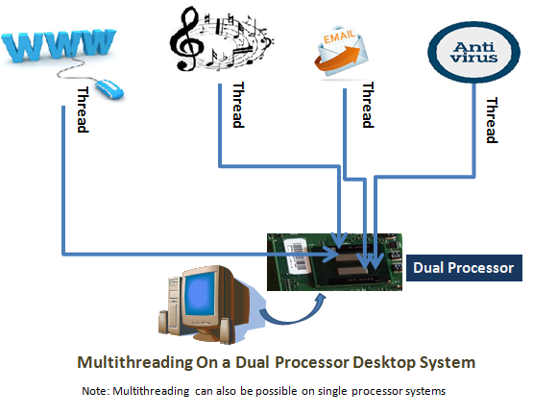

Slide 4
Difference between multi-threading and multi-processing
By formal definition, multithreading refers to the ability of a processor to execute multiple threads concurrently,
where each thread runs a process.
Whereas multiprocessing refers to the ability of a system to run multiple processors concurrently, where each processor can run one or more threads.

Slide 5
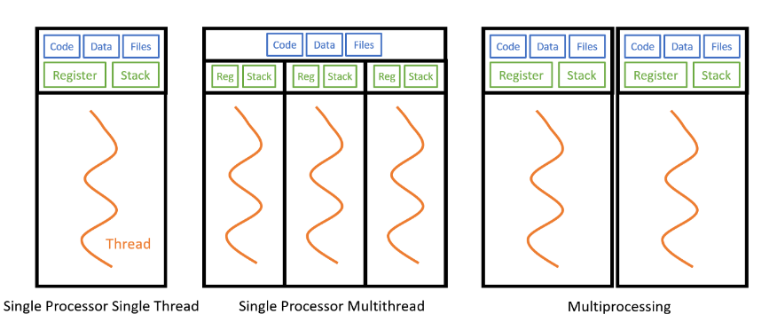
Multi-threading vs multi-processing
in multithreading multiple threads share the same code, data, and files but run on a different register and stack.
Multiprocessing multiplies a single processor — replicating the code, data, and files, which incurs more overhead.
Multithreading is useful for IO-bound processes,
such as reading files from a network or database since each thread can run the IO-bound process concurrently.
Multiprocessing is useful for CPU-bound processes,
such as computationally heavy tasks since it will benefit from having multiple processors;

Slide 6
Advantages of Java Multithreading
1) It doesn't block the user because threads are independent and you can perform multiple operations at the same time.
2) You can perform many operations together, so it saves time.
3) Threads are independent, so it doesn't affect other threads if an exception occurs in a single thread.

Slide 7
Advantages of Java Multithreading
1) It doesn't block the user because threads are independent and you can perform multiple operations at the same time.
2) You can perform many operations together, so it saves time.
3) Threads are independent, so it doesn't affect other threads if an exception occurs in a single thread.

Slide 8
What is Thread in java
A thread is a lightweight subprocess, the smallest unit of processing. It is a separate path of execution.
Threads are independent.
If there occurs exception in one thread, it doesn't affect other threads.
It uses a shared memory area.

Slide 9
Java Thread class
Java provides Thread class to achieve thread programming.
Thread class provides constructors and methods to create and perform operations on a thread.
Thread class extends Object class and implements Runnable interface.

Slide 10
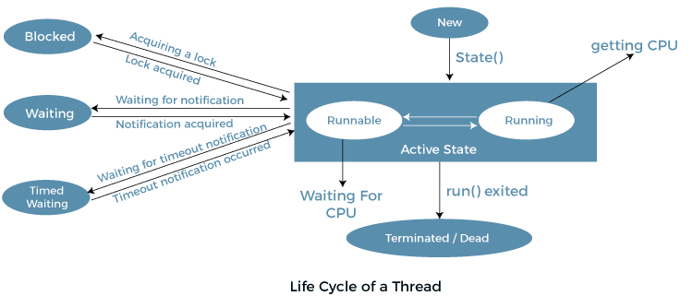
Life cycle of a Thread (Thread States)
In Java, a thread always exists in any one of the following states. These states are:
New
Active
Blocked / Waiting
Timed Waiting
Terminated

Slide 11
Different Thread States
New: Whenever a new thread is created, it is always in the new state.
For a thread in the new state, the code has not been run yet and thus has not begun its execution.

Slide 12
Different Thread States
Active: When a thread invokes the start() method,
it moves from the new state to the active state. The active state contains two states within it:
one is runnable, and the other is running.

Slide 13
Runnable:
A thread, that is ready to run is then moved to the runnable state.
In the runnable state, the thread may be running or may be ready to run at any given instant of time.
It is the duty of the thread scheduler to provide the thread time to run, i.e., moving the thread the running state.
A program implementing multithreading acquires a fixed slice of time to each individual thread.
Each and every thread runs for a short span of time and when that allocated time slice is over, the thread voluntarily gives up the CPU to the other thread, so that the other threads can also run for their slice of time.
In the runnable state, there is a queue where the threads lie.

Slide 14
Running:
When the thread gets the CPU, it moves from the runnable to the running state.
Generally, the most common change in the state of a thread is from runnable to running and again back to runnable.

Slide 15
Blocked or Waiting:
Whenever a thread is inactive for a span of time (not permanently) then, either the thread is in the blocked state or is in the waiting state.
For example, a thread (let's say its name is A) may want to print some data from the printer.
However, at the same time, the other thread (let's say its name is B) is using the printer to print some data.
Therefore, thread A has to wait for thread B to use the printer.
Thus, thread A is in the blocked state.
A thread in the blocked state is unable to perform any execution and thus never consume any cycle of the Central Processing Unit (CPU).
Hence, we can say that thread A remains idle until the thread scheduler reactivates thread A, which is in the waiting or blocked state.

Slide 16
Timed Waiting:
Sometimes, waiting for leads to starvation.
For example, a thread (its name is A) has entered the critical section of a code and is not willing to leave that critical section.
In such a scenario, another thread (its name is B) has to wait forever, which leads to starvation.
To avoid such scenario, a timed waiting state is given to thread B.
Thus, thread lies in the waiting state for a specific span of time, and not forever.
A real example of timed waiting is when we invoke the sleep() method on a specific thread.
The sleep() method puts the thread in the timed wait state. After the time runs out, the thread wakes up and start its execution from when it has left earlier.

Slide 17
Terminated:
A thread reaches the termination state because of the following reasons:
When a thread has finished its job, then it exists or terminates normally.
Abnormal termination: It occurs when some unusual events such as an unhandled exception or segmentation fault.
A terminated thread means the thread is no more in the system. In other words, the thread is dead, and there is no way one can respawn (active after kill) the dead thread.

Slide 18
Implementation of Thread States
In Java, one can get the current state of a thread using the Thread.getState() method. The java.lang.Thread.State class of Java provides the constants ENUM to represent the state of a thread. These constants are:
public static final Thread.State NEW
It represents the first state of a thread that is the NEW state.
public static final Thread.State RUNNABLE
It represents the runnable state.It means a thread is waiting in the queue to run.
public static final Thread.State BLOCKED
It represents the blocked state. In this state, the thread is waiting to acquire a lock.
public static final Thread.State WAITING
It represents the waiting state.
A thread will go to this state when it invokes the Object.wait() method, or Thread.join() method with no timeout.
A thread in the waiting state is waiting for another thread to complete its task.
public static final Thread.State TIMED_WAITING
public static final Thread.State TERMINATED

Slide 19
Sequential processing
class hi{
public void show() throws Exception{
for(int i=1;i<=5;i++){
System.out.println("Hi");
Thread.sleep(500);
}
}//show
}//hi
class hello{
public void show() throws Exception{
for(int i=1;i<=5;i++){
System.out.println("Hello");
Thread.sleep(500);
}
}//show
}//hi

Slide 20
class tdemo{
public static void main(String [] args) throws Exception{
hi obj1=new hi();
obj1.show();
hello obj2=new hello();
obj2.show();
}
}

Slide 21
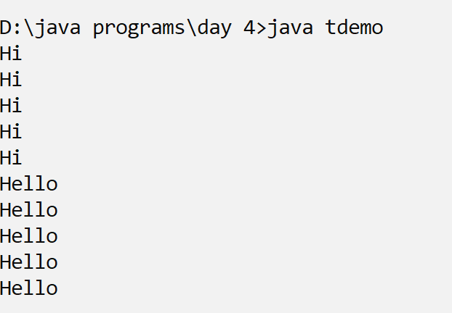
output

Slide 22
Multithreading
class hi extends Thread{
public void run() {
for(int i=1;i<=5;i++){
System.out.println("Hi");
try{
Thread.sleep(500);
}catch(Exception e){}
}
}//show
}//hi
class hello extends Thread{
public void run() {
for(int i=1;i<=5;i++){
System.out.println("Hello");
try{
Thread.sleep(500);
}catch(Exception e){}
}
}//show
}//hi

Slide 23
Main class
class tdemo2{
public static void main(String [] args) throws Exception{
hi obj1=new hi();
hello obj2=new hello();
obj1.start();
obj2.start();
}
}

Slide 24
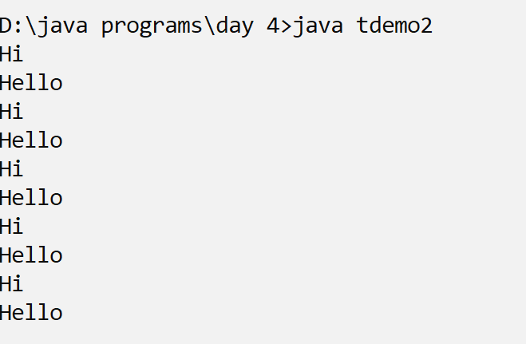
output

Slide 25
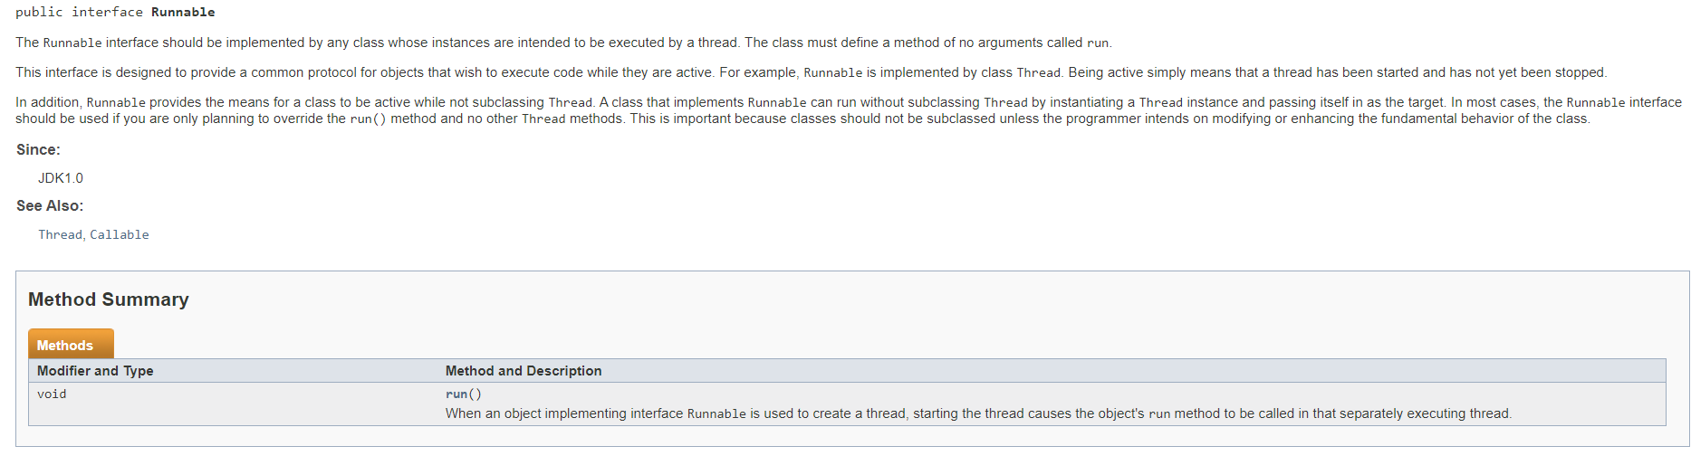
Runnable interface

Slide 26
Multithreading using Runnable interface
class hi implements Runnable{
public void run() {
for(int i=1;i<=5;i++){
System.out.println("Hi");
try{
Thread.sleep(500);
}catch(Exception e){}
}
}//show
}//hi
class hello implements Runnable{
public void run() {
for(int i=1;i<=5;i++){
System.out.println("Hello");
try{
Thread.sleep(500);
}catch(Exception e){}
}
}//show
}//hi

Slide 27
Multithreading using Runnable interface
class tdemo3{
public static void main(String [] args) throws Exception{
Runnable obj1=new hi();
Runnable obj2=new hello();
Thread t1=new Thread(obj1);
Thread t2=new Thread(obj2);
t1.start();
t2.start();
}
}

Slide 28
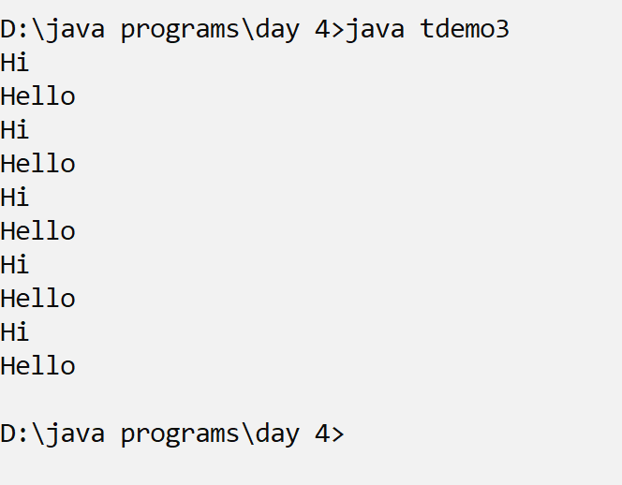
output

Slide 29
Implementing runnable interface through lambda
class tdemo4{
public static void main(String [] args) throws Exception{
Runnable obj1=()->{
for(int i=1;i<=5;i++){
System.out.println("Hi");
try{
Thread.sleep(500);
}catch(Exception e){}
}//for
};
Runnable obj2=()->{
for(int i=1;i<=5;i++){
System.out.println("Hello");
try{
Thread.sleep(500);
}catch(Exception e){}
}//for
};
Thread t1=new Thread(obj1);
Thread t2=new Thread(obj2);
t1.start();
t2.start();
}
}

Slide 30
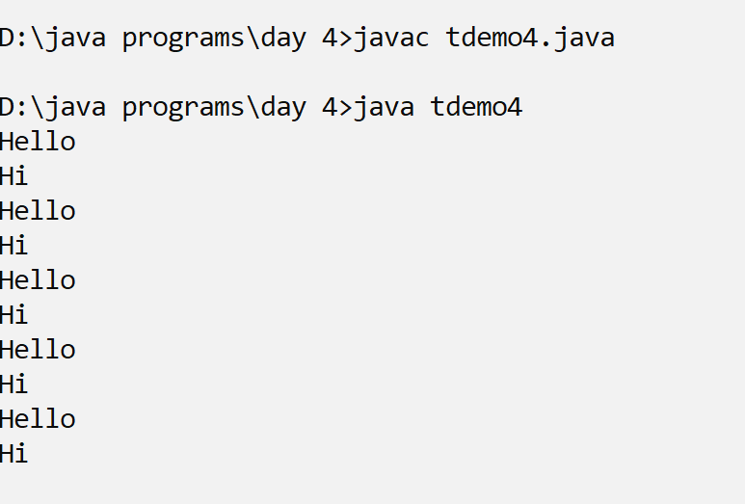
output

Slide 31
Adding task to the main thread
class tdemo5{
public static void main(String [] args) throws Exception{
Runnable obj1=()->{
for(int i=1;i<=5;i++){
System.out.println("Hi");
try{
Thread.sleep(500);
}catch(Exception e){}
}//for
};
Runnable obj2=()->{
for(int i=1;i<=5;i++){
System.out.println("Hello");
try{
Thread.sleep(500);
}catch(Exception e){}
}//for
};

Slide 32
Main thread printing bye
Thread t1=new Thread(obj1);
Thread t2=new Thread(obj2);
t1.start();
t2.start();
System.out.println("Good bye");
}
}

Slide 33
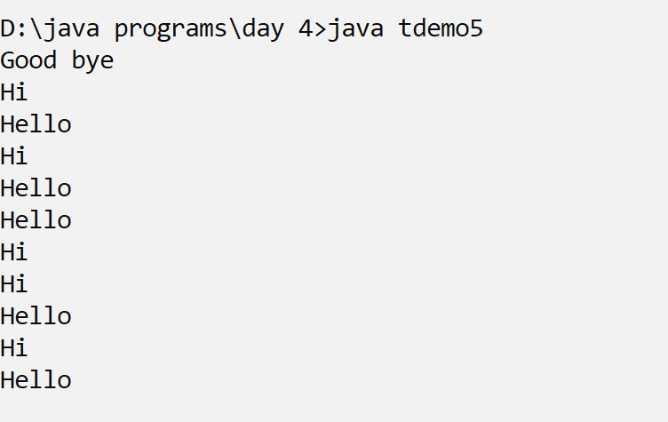
output

Slide 34
S.N. | Modifier and Type | Method | Description
1) | void | start() | It is used to start the execution of the thread.
2) | void | run() | It is used to do an action for a thread.
3) | static void | sleep() | It sleeps a thread for the specified amount of time.
4) | static Thread | currentThread() | It returns a reference to the currently executing thread object.
5) | void | join() | It waits for a thread to die.
6) | int | getPriority() | It returns the priority of the thread.
7) | void | setPriority() | It changes the priority of the thread.
8) | String | getName() | It returns the name of the thread.
9) | void | setName() | It changes the name of the thread.
10) | long | getId() | It returns the id of the thread.

Slide 35
11) | boolean | isAlive() | It tests if the thread is alive.
12) | static void | yield() | It causes the currently executing thread object to pause and allow other threads to execute temporarily.
13) | void | suspend() | It is used to suspend the thread.
14) | void | resume() | It is used to resume the suspended thread.
15) | void | stop() | It is used to stop the thread.
16) | void | destroy() | It is used to destroy the thread group and all of its subgroups.
17) | boolean | isDaemon() | It tests if the thread is a daemon thread.
18) | void | setDaemon() | It marks the thread as daemon or user thread.
19) | void | interrupt() | It interrupts the thread.
20) | boolean | isinterrupted() | It tests whether the thread has been interrupted.

Slide 36
Make the main thread to wait
Thread t1=new Thread(obj1);
Thread t2=new Thread(obj2);
t1.start();
t2.start();
t1.join();
t2.join();
System.out.println("Good bye");
}
}

Slide 37
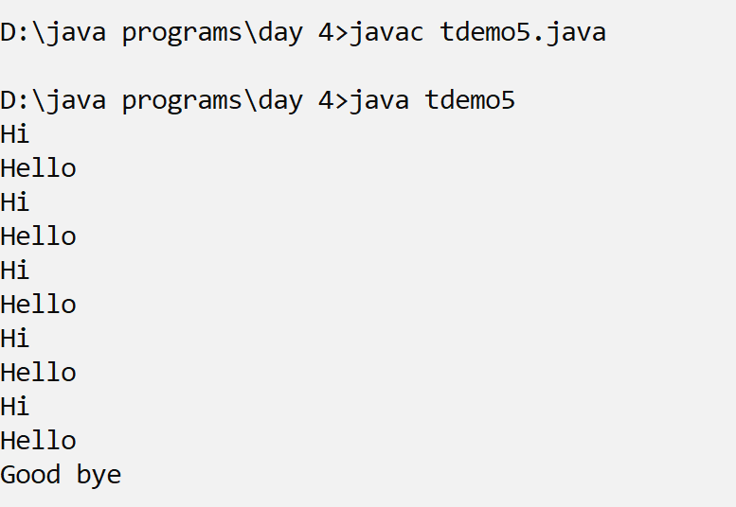
output

Slide 38
Checking if the thread is alive
Thread t1=new Thread(obj1);
Thread t2=new Thread(obj2);
t1.start();
t2.start();
System.out.println(t1.isAlive());
System.out.println(t2.isAlive());
t1.join();
t2.join();
System.out.println(t1.isAlive());
System.out.println(t2.isAlive());
System.out.println("Good bye");

Slide 39
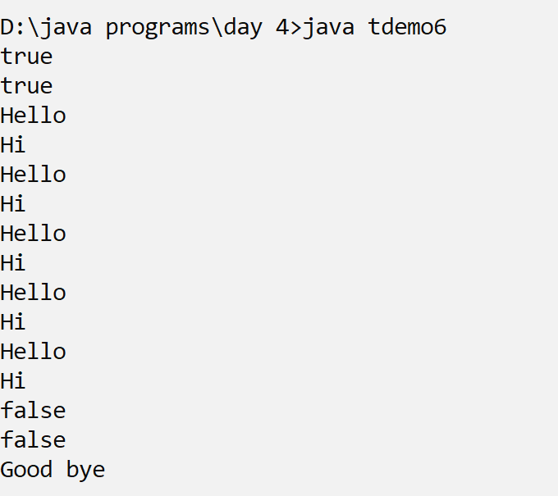
output

Slide 40
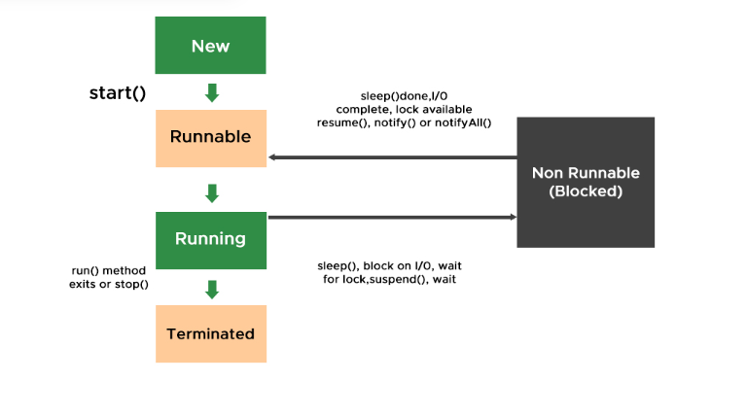

Slide 41
Yield(): allows the currently executing thread to pause
t1.start();
t2.start();
t1.yield();
System.out.println("t1 state:"+t1.getState());
System.out.println("t1 state:"+t1.getState());
System.out.println("t1 state:"+t1.getState());
System.out.println("Good bye");
}
}

Slide 42
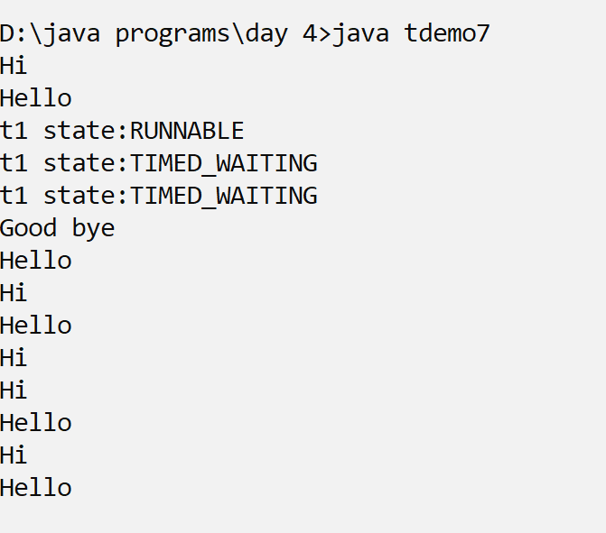
output

Slide 43
Why suspend and resume methods were removed
Suspend() method is deadlock prone. If the target thread holds a lock on object when it is suspended, no thread can lock this object until the target thread is resumed.
If the thread that would resume the target thread attempts to lock this monitor prior to calling resume, it results in deadlock formation.
These deadlocks are generally called Frozen processes.
Suspend() method puts thread from running to waiting state. And thread can go from waiting to runnable state only when resume() method is called on thread. It is deprecated method.

Slide 44
Deadlocks
Resource Deadlocks
A process needs multiple resources for an activity.
Deadlock occurs if each process in a set request resources
held by another process in the same set, and it must receive
all the requested resources to move further.
Communication Deadlocks
Processes wait to communicate with other processes in a set.
Each process in the set is waiting on another process’s
message, and no process in the set initiates a message
until it receives a message for which it is waiting.

Slide 45
Graph Models
Nodes of a graph are processes. Edges of a graph the pending requests or assignment of resources.
Wait-for Graphs (WFG): P1 -> P2 implies P1 is waiting for a resource from P2.
Transaction-wait-for Graphs (TWF): WFG in databases.
Deadlock: directed cycle in the graph.
Cycle example:
P1
P2

Slide 46
Graph Models
Wait-for Graphs (WFG): P1 -> P2 implies P1 is waiting for a resource from P2.
P1
R1
R2
P2

Slide 47
Priority of thread
Each thread has a priority. Priorities are represented by a number between 1 and 10.
In most cases, the thread scheduler schedules the threads according to their priority (known as preemptive scheduling).

Slide 48
Setter & Getter Method of Thread Priority
Let's discuss the setter and getter method of the thread priority.
public final int getPriority(): The java.lang.Thread.getPriority() method returns the priority of the given thread.
public final void setPriority(int newPriority):
The java.lang.Thread.setPriority() method updates or assign the priority of the thread to newPriority.
The method throws IllegalArgumentException if the value newPriority goes out of the range, which is 1 (minimum) to 10 (maximum).

Slide 49
3 constants defined in Thread class:
public static int MIN_PRIORITY
public static int NORM_PRIORITY
public static int MAX_PRIORITY

Slide 50
Setting priority
t1.start();
t1.setPriority(Thread.MAX_PRIORITY);
t2.start();
t2.setPriority(Thread.MIN_PRIORITY);
System.out.println("t1 alive?"+t1.isAlive());
System.out.println("t1 priority:"+t1.getPriority());
t1.yield();
System.out.println("t1 alive?"+t1.isAlive());
System.out.println("t2 priority:"+t2.getPriority());

Slide 51
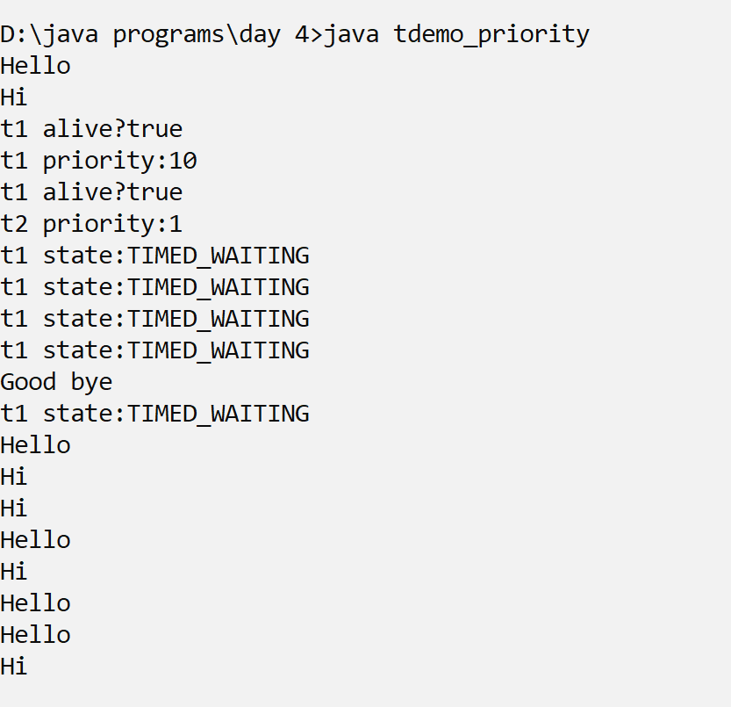
Setting priority

Slide 52
Thread priorities
Thread priorities are highly OS specific and on many operating systems often have minimal effect.
Priorities help to order the threads that are in the run queue only and will not change how often the threads are run in any major way unless you are doing a ton of CPU in each of the threads.

Slide 53
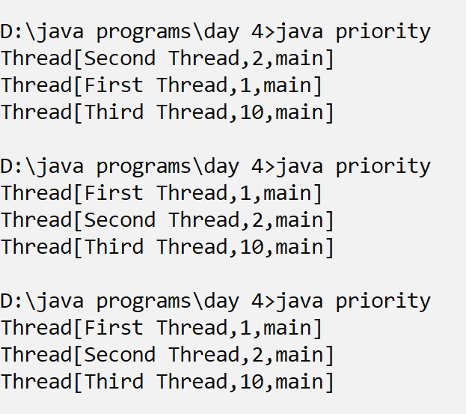

Slide 54
Interprocess synchronization
Multi-threaded programs may often come to a situation where multiple threads try to access the same resources and finally produce erroneous and unforeseen results.
So it needs to be made sure by some synchronization method that only one thread can access the resource at a given point in time.
Java provides a way of creating threads and synchronizing their tasks using synchronized blocks. Synchronized blocks in Java are marked with the synchronized keyword.

Slide 55
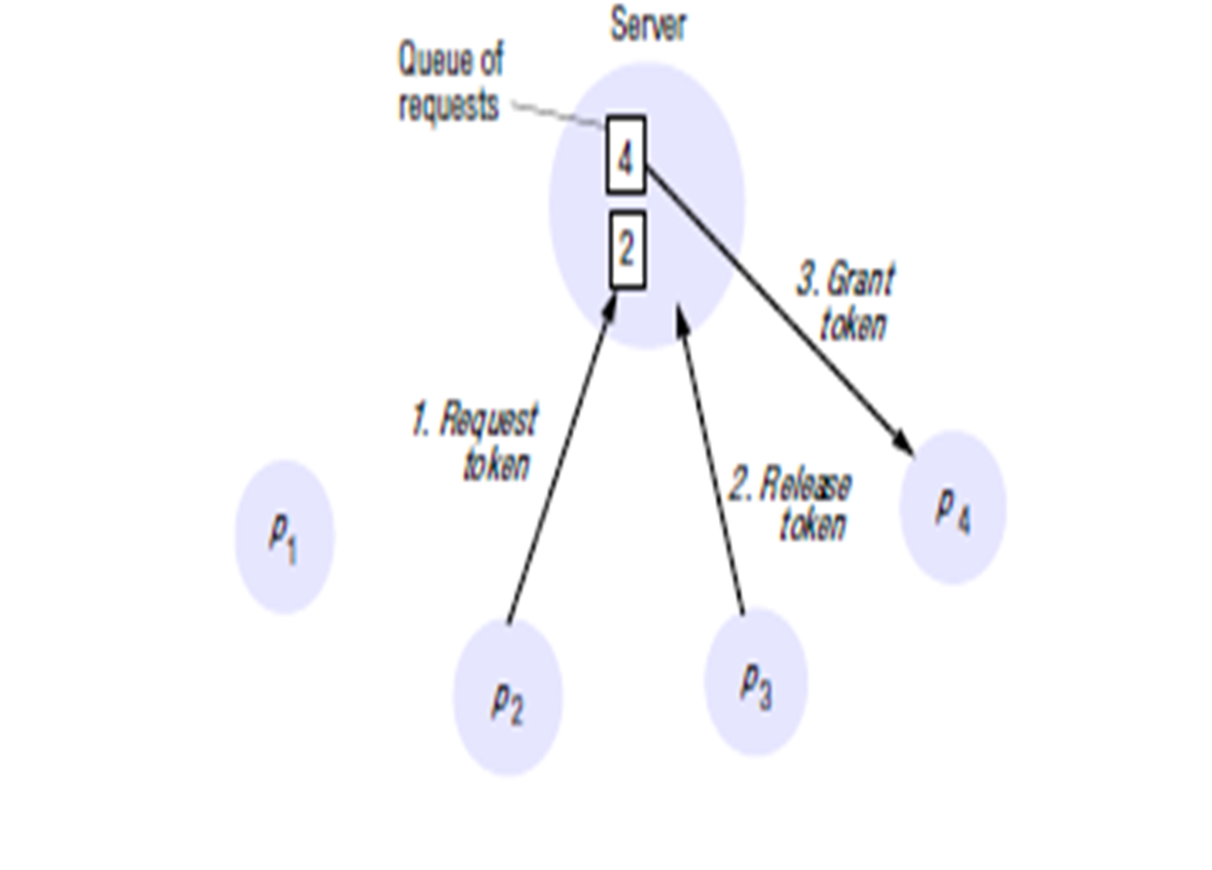
Mutual exclusion
The application-level protocol for executing a critical section is as follows:
enter() // enter critical section – block if necessary
resourceAccesses() // access shared resources in critical section
exit() // leave critical section – other processes may now enter

Slide 56
Token Ring Algorithm
One of the simplest ways to arrange mutual exclusion between the N processes without requiring an additional process is to arrange them in a logical ring.
This requires only that each process pi has a communication channel to the next process in the ring, pi + 1 mod N .
The idea is that exclusion is conferred by obtaining a token in the form of a message passed from process to process in a single direction.

Slide 57
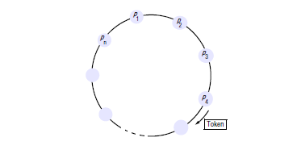

Slide 58
Program demo for synchronization
import java.io.*;
class account implements Runnable{
int balance;
account(int bal){
this.balance=bal;
}
public synchronized void run() {
for(int i=0;i<=3;i++){
try{
System.out.println(Thread.currentThread().getName());
DataInputStream in=new DataInputStream(System.in);
System.out.println("Enter amount to withdraw?");
int amt=Integer.parseInt(in.readLine());
if (amt>balance)
System.out.println("insufficient balance");
else
balance=balance-amt;
System.out.println("Current balance:"+balance);
}

Slide 59
Class main
class account_main{
public static void main(String [] args) throws Exception{
account a=new account(10000);
Thread t1=new Thread(a,"user A:");
Thread t2=new Thread(a,"User B:");
t1.start();
t2.start();
t1.join();
t2.join();
System.out.println("balance="+a.balance);}}

Slide 60
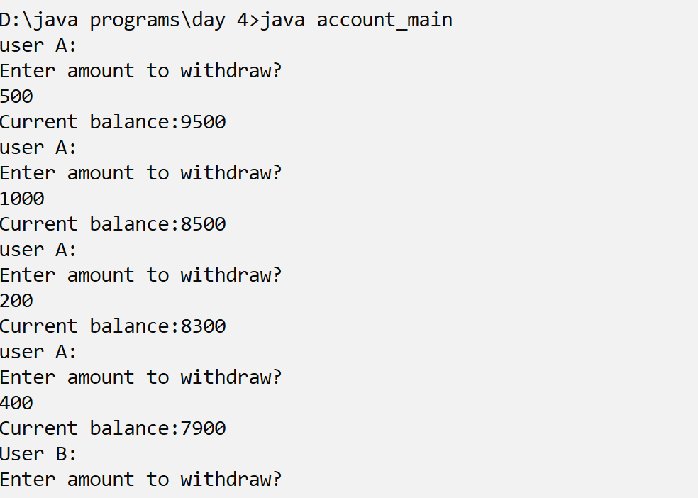
output

Slide 61
Inter-thread Communication in Java
Inter-thread communication in Java is a mechanism in which a thread is paused running in its
critical section and another thread is allowed to enter (or lock) in the same critical section to be executed.

Slide 62
What is Polling, and what are the problems with it?
The process of testing a condition repeatedly till it becomes true is known as polling.
Polling is usually implemented with the help of loops to check whether a particular condition is true or not.
If it is true, a certain action is taken.
This wastes many CPU cycles and makes the implementation inefficient.

Slide 63
How Java multi-threading tackles this problem?
To avoid polling, Java uses three methods, namely, wait(), notify(), and notifyAll().
All these methods belong to object class as final so that all classes have them.
They must be used within a synchronized block only.
wait(): It tells the calling thread to give up the lock and go to sleep until some other thread enters the same monitor and calls notify().
notify(): It wakes up one single thread called wait() on the same object.
It should be noted that calling notify() does not give up a lock on a resource.
notifyAll(): It wakes up all the threads called wait() on the same object.

Slide 64
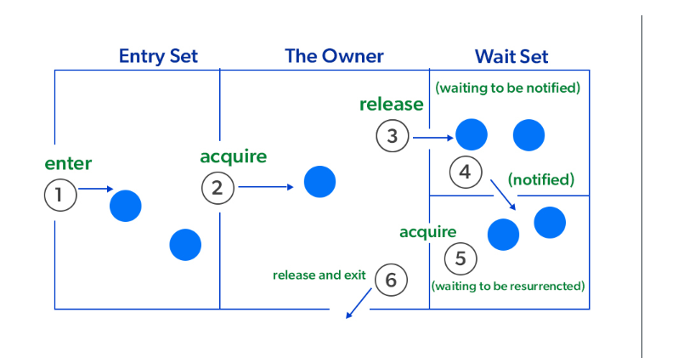

Slide 65
Synchronized block
A Synchronized block is a piece of code that can be used to perform synchronization on any specific resource of the method.
A Synchronized block is used to lock an object for any shared resource

Slide 66
syntax
synchronized (object reference expression) {
//code block
}

Slide 67
Synchronization
import java.io.*;
import java.util.*;
class tdemo_sync {
public static void main(String [] args) throws Exception{
class_sync c=new class_sync();
Thread t1=new Thread(()->{
try{
c.produce();
Thread.sleep(500);
}catch(Exception e){}
});
Thread t2=new Thread(()->{
try{
c.consume();
Thread.sleep(500);
}catch(Exception e){}
});
t1.start();
t2.start();
}
}

Slide 68
Synchronized block
class class_sync
{
// Prints a string and waits for consume()
public void produce()throws Exception
{
// synchronized block ensures only one thread
// running at a time.
synchronized(this)
{
System.out.println("producer thread running");
// releases the lock on shared resource
wait();
// and waits till some other method invokes notify().
System.out.println("Resumed");
}
}

Slide 69
Synchronized block
// Sleeps for some time and waits for a key press. After key
// is pressed, it notifies produce().
public void consume()throws Exception
{
// this makes the produce thread to run first.
Thread.sleep(1000);
Scanner s = new Scanner(System.in);
synchronized(this)
{
System.out.println("Waiting for return key.");
s.nextLine();
System.out.println("Return key pressed");
// notifies the produce thread that it
// can wake up.
notify();
// Sleep
Thread.sleep(2000);
}

Slide 70
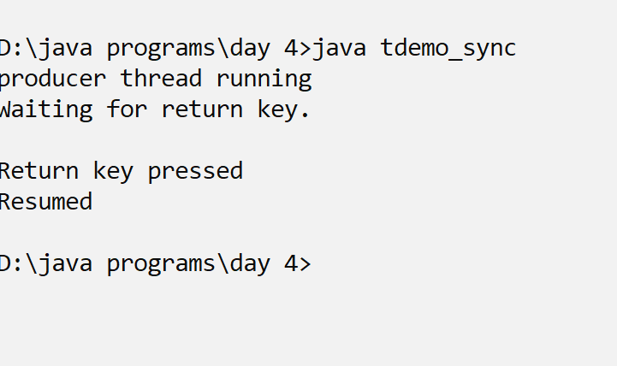
output

Slide 71
Thank you

